Slide 1


IS4S761 Principles of Computing
Introduction to Python Programming
David Kidner (J302)
david.kidner@southwales.ac.uk

Slide 2
Introduction to Programming
Computers are Everywhere!
How many computers do you own?
Depends on your definition of what a computer is!
Mainframe
Desktop
Laptop
Tablet / Notebook
Mobile Phone
Embedded System
i.e. is a programmed controlling and operating system (small processor or computer) with a dedicated function within a larger mechanical or electrical system
e.g. Washing machine, car, games system, microwave, etc.
Usually preset programs.

Slide 3
Computer Programs
Computers are useful because they run various programs
A Program is simply a set of instructions to complete some task
How many different programs do you use in a day?
E.g. Alarm Clock, e-mail, Facebook, BLACKBOARD, etc.
Definition: A Sequence of Instructions that are to be carried out by the Computer.
A systematic set of rules used to describe computations, generally in a format that is understandable and editable by humans.

Slide 4
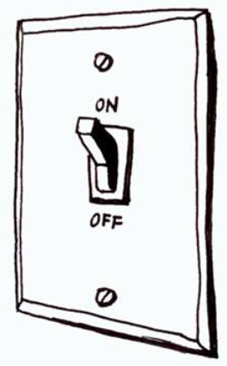
Computer Programming
Computers are Pretty Fast!
Today’s typical PCs with a multi-core processor are capable of processing over 100 Billion Instructions per Second!
Computers are Pretty Dumb!
At the base level, they only understand …
… or machine code of 0s and 1s.
They do what they are told to do …
Pretty Fast, Generally without making mistakes, and often without getting bored!

Slide 5
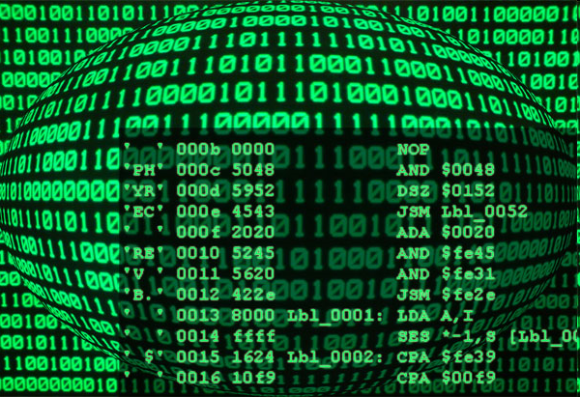
Computer Programming
So, if computers are pretty dumb and can only carry out a limited set of distinct instructions, how do we go about developing a program?
We know that a program’s commands and data are stored as sequences of bits in the computer's memory
Programming with Strings of bits (1s or 0s) is not the easiest thing in the World.

Slide 6
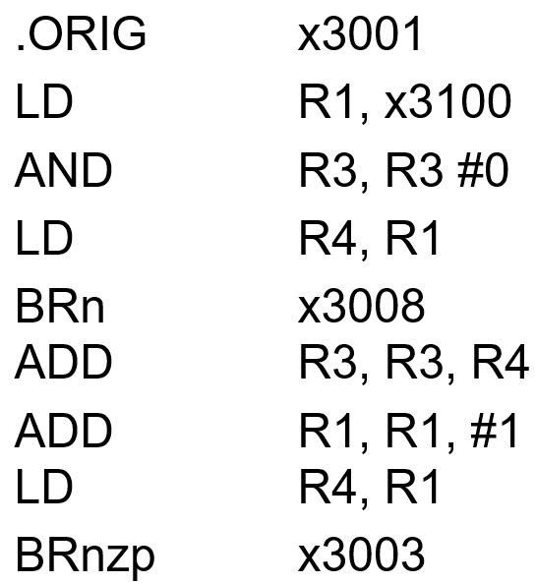
Low Level Programming
An Assembly language (Assembler) is any low-level programming language in which there is a very strong correspondence between the program's statements and the architecture's machine code instructions.
mnemonics for machine language instructions …

Slide 7
High Level Programming
Assembly language, still not so easy, and lots of commands to accomplish things.
e.g. to add two numbers
Load the number from memory location 3001 into the CPU
Load the number from memory location 3002 into the CPU
Add the two numbers in the CPU
Store the result into location 3003
High Level Computer Languages provide the ability to accomplish a lot with fewer commands than machine or assembly language in a way that is hopefully easier to understand.
e.g. to add two numbers
C = A + B
This still needs to be translated into machine language that the computer can execute.

Slide 8
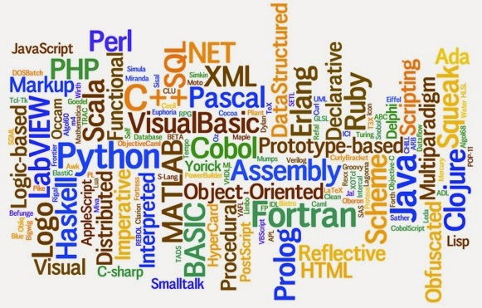
High Level Programming
There’s plenty to choose from …

Slide 9
High Level Programming
Just like many different languages spoken by people around the world → there are many different programming languages to choose from
Some were developed to improve on previous ones, with additional functionality
Some for specific applications
Can be classed as compiled or interpreted
Compiled – the program after writing is converted to machine language/instructions
Interpreted – the program is translated to machine code when run

Slide 10
High Level Programming
There’s plenty to choose from …
The capabilities of the languages vary widely, but they all need a way to do
declarative statements
conditional statements
iterative or repetitive statements
A compiler is a program that converts commands in high level languages to machine language instructions

Slide 11
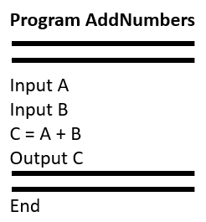
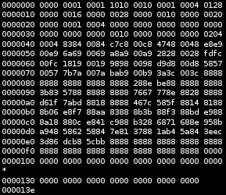
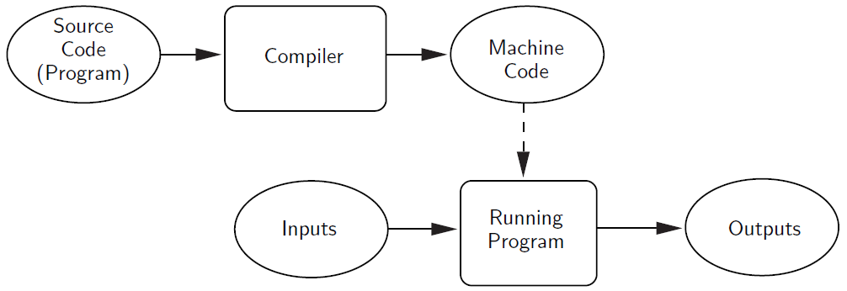


Compiling High Level Code

Slide 12
Interpreting High Level Code
Not all High Level Programs are Compiled. Some are Interpreted.
Interpreters simulate a computer that understands a High-Level language.
The source program is not translated into machine language all at once.
An interpreter analyses and executes the source code instruction by instruction.

Slide 13
Interpreting High Level Code

Slide 14
Compiling vs. Interpreting
Once program is compiled, it can be executed over and over without the source code or compiler.
If it is interpreted, the source code and interpreter are needed each time the program runs.
Compiled programs generally run faster since the translation of the source code happens only once.

Slide 15
Compiling vs. Interpreting
Interpreted languages are part of a more flexible programming environment since they can be developed and run interactively
Interpreted programs are more portable, meaning the executable code produced from a compiler for an Intel PC won’t run on a Mac, without recompiling. If a suitable interpreter already exists, the interpreted code can be run with no modifications.

Slide 16
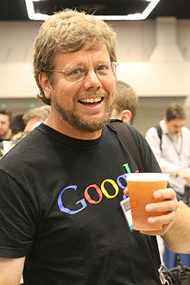
PYTHON
Conceived in 1980s, implemented by Guido van Rossum (BDFL*) beginning 1989 as successor to ABC
High-level
General purpose, Scripting
Interpreted
Dynamic programming language
Emphasis on readability
Automatic memory management
*Benevolent Dictator For Life

Slide 17


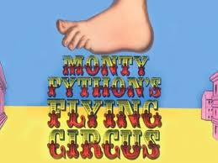

Principles of Computing: Why PYTHON?
Programming You THOught Nice

Slide 18
Why Use PYTHON?
IEEE ranked Python as the #1 Programming Language in 2017, 2018 and 2019. Enough Said!
Python is an accessible language for new programmers because the community provides many introductory resources.
An Open Source “Ecosystem” - expansive library of open source data analysis tools, frameworks and testing instruments make it one of the largest out of any programming community.
Quick to Learn!
Easy to Use!

Slide 19
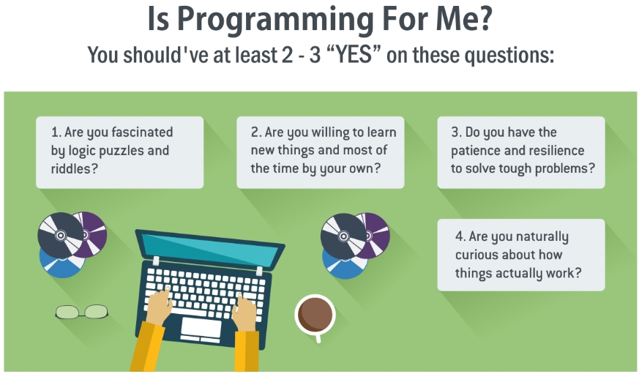
5. Are you enrolled on IS4S761?
(Answer Counts as 2).

Slide 20

What Makes a Good Programmer?
Logical Thinking
Creative Thinking
Problem Solving Skills
The Ability to “Think Outside of the Box”
Communication Skills
Willingness to Learn (By Example)
Laziness! (Finding the Quickest/Easiest Solution).
Not Just Technical Skills!

Slide 21
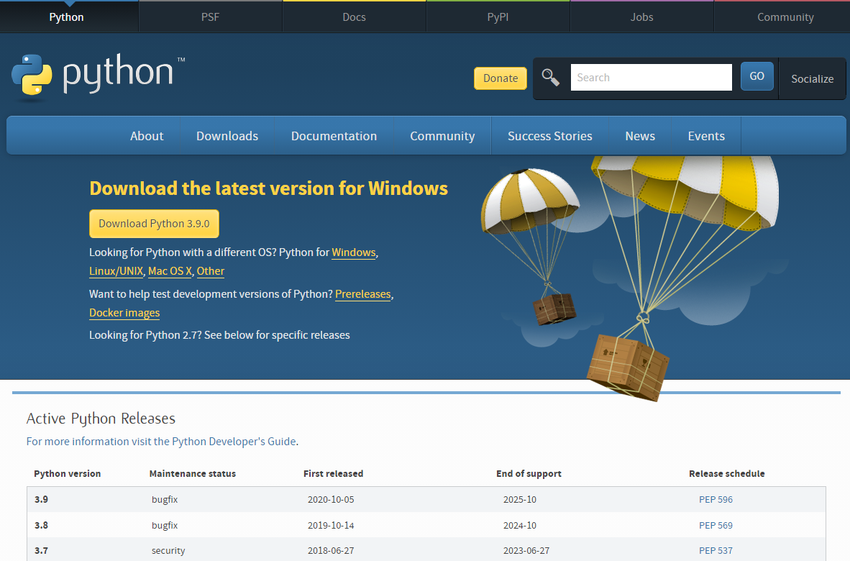
Install on your own PC / Laptop https://www.python.org/downloads/

Slide 22
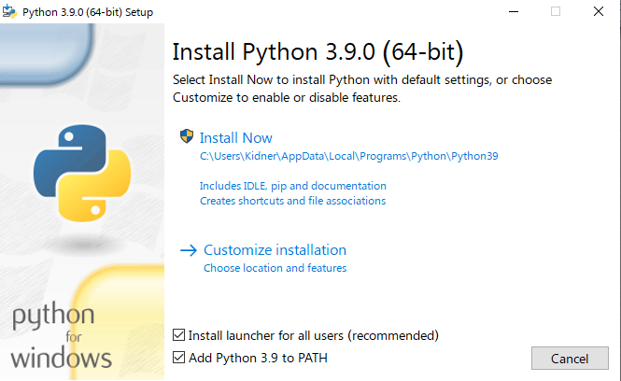
Download & Run (Install Now)
Check
Add Python 3.9 to PATH
(makes it more accessible on your PC)

Slide 23
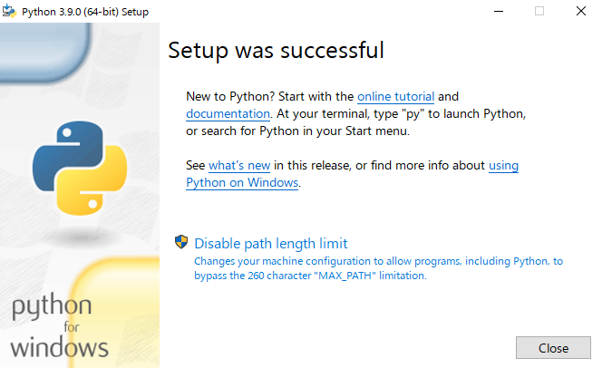

Slide 24
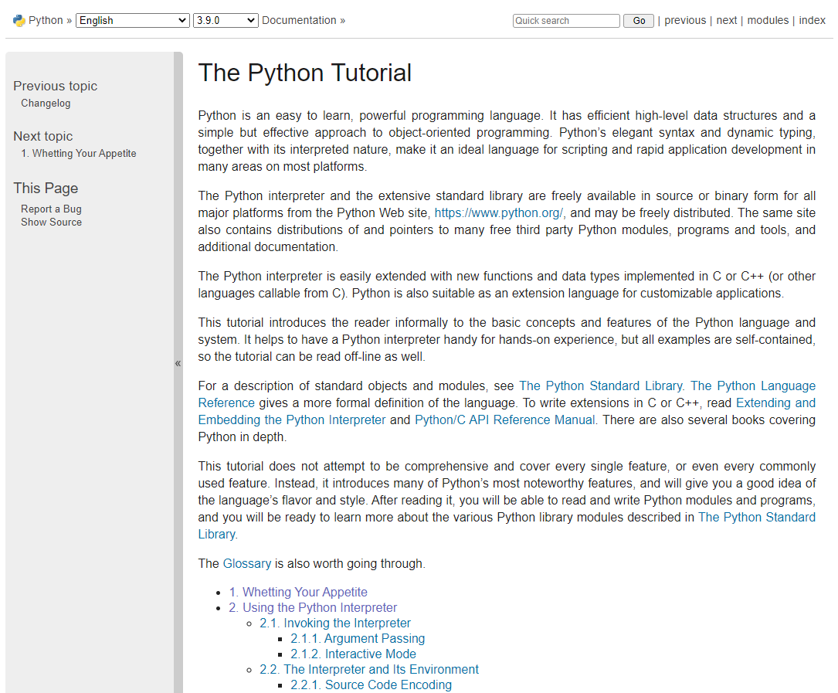
https://docs.python.org/3.9/tutorial/index.html

Slide 25
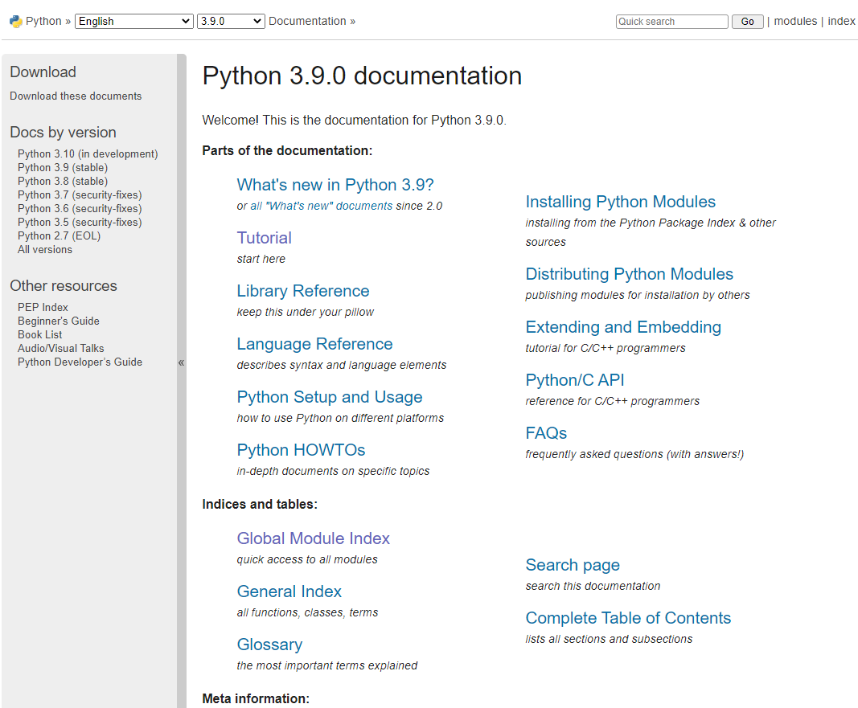
https://docs.python.org/3.9/index.html

Slide 26
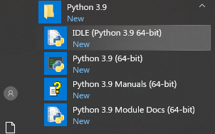
Python 3.9
Should be visible in your Windows Menu …
Earlier versions might be available on your PC or in Uni Labs, e.g. 2.X, 3.7, etc.
In some Labs, you might have to Search for it …
Type Python

Slide 27
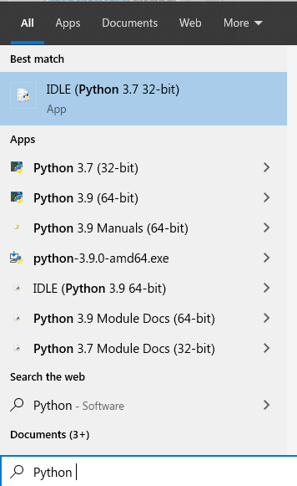
Python 3.9
We have a multitude of options, so we need to be CAREFUL as to what we open / use.
Very Confusing?
Too easy to open the wrong (or old) version ….

Slide 28
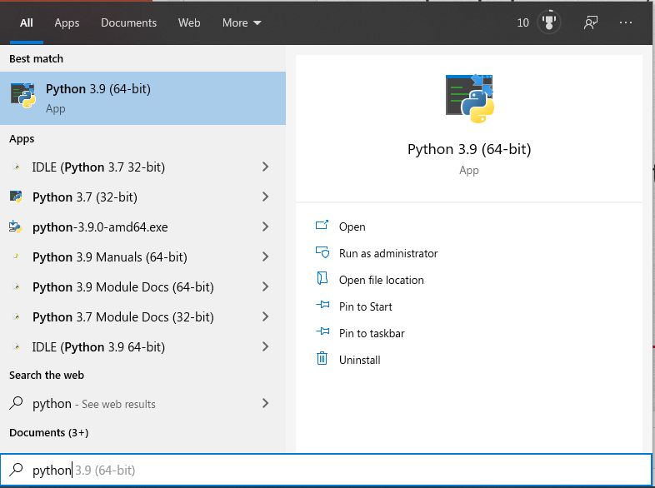
Adds

Slide 29
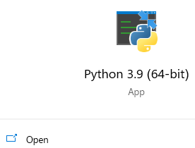
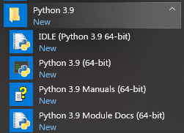

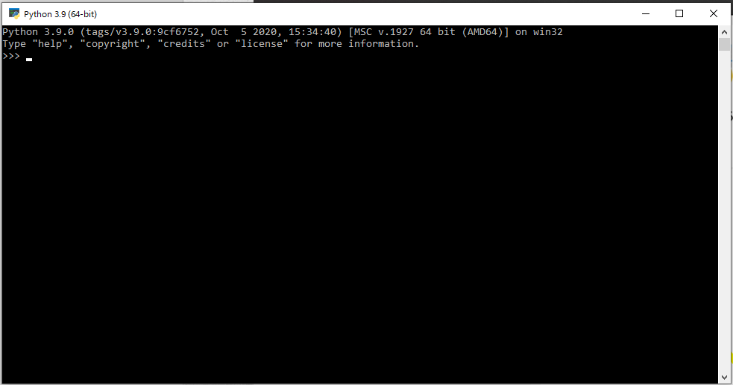
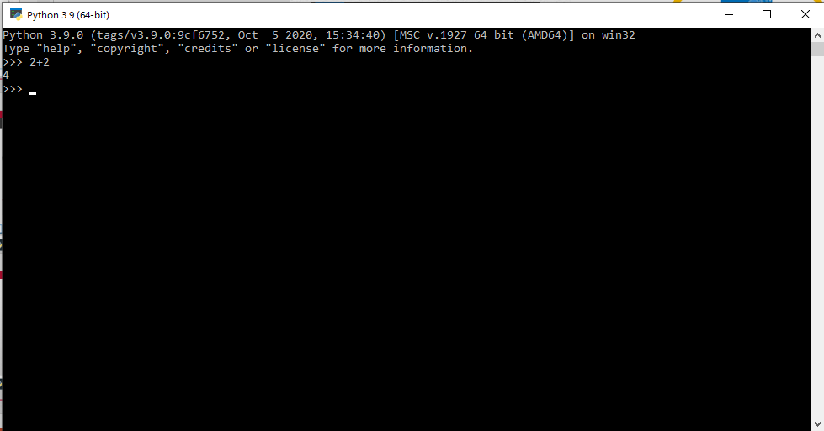

Opens Interpreter Window, so we can start programming

Slide 30
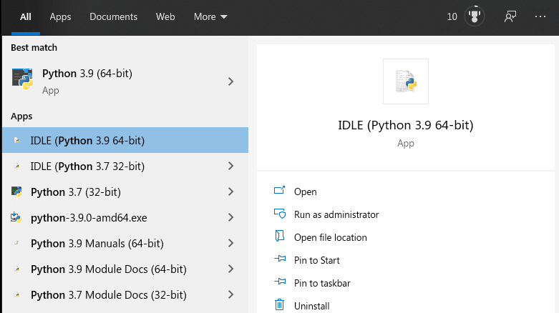
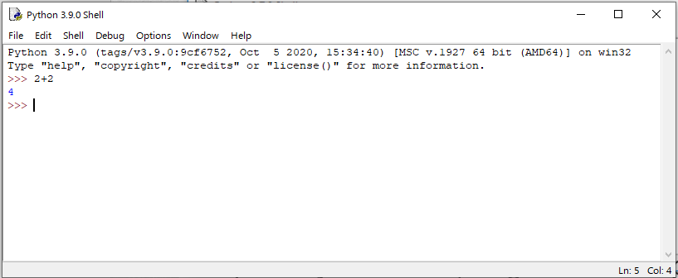
Opens Python IDLE (Integrated Development and Learning Environment) Shell Window, so we can start programming and easily open and run Python scripts (programs).

Slide 31
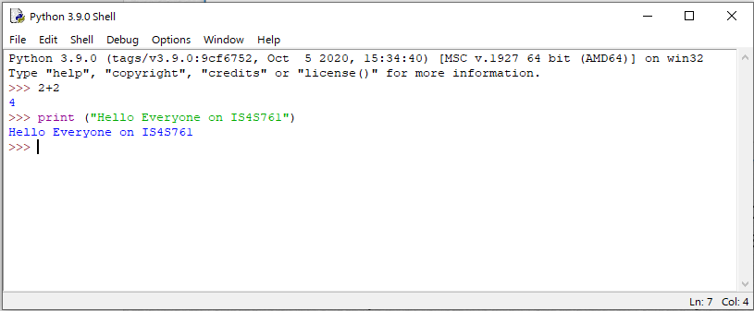
Python IDLE
When we start programming in the Python IDLE, you will notice that your code will automatically change into different colours.
The colours represent different elements of Python code.

Slide 32
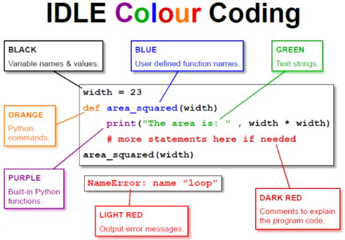
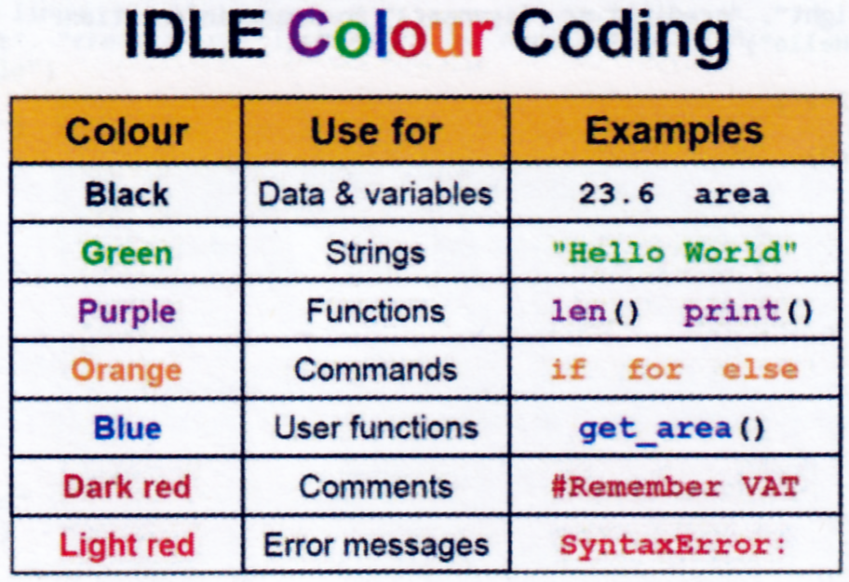
Python IDLE

Slide 33
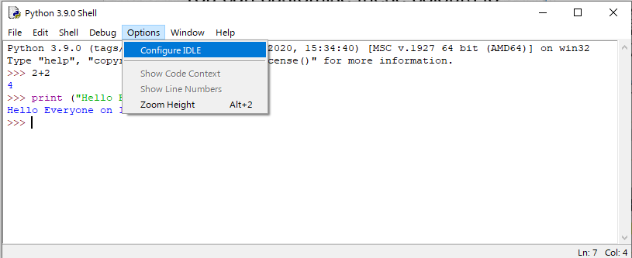
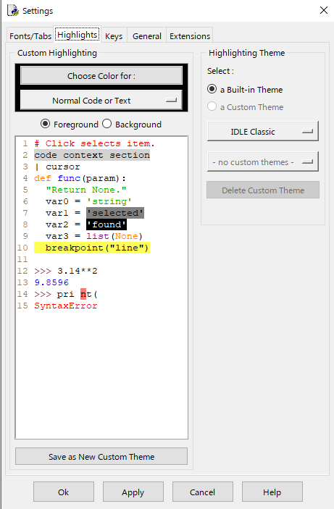
Python IDLE
You can customise these colours to your own preferences if you like.
As well as other settings on the tabs …

Slide 34
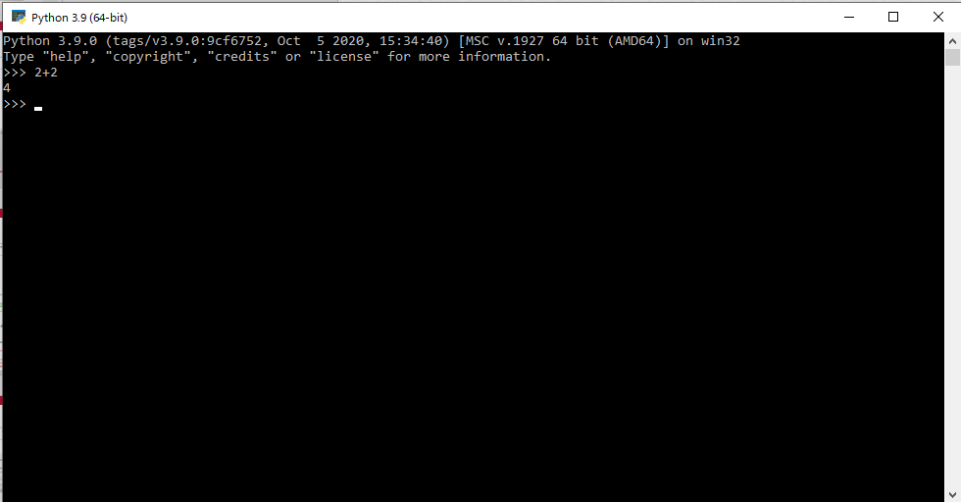
Getting Started with Python
In any application, especially programming, when faced with an unfamiliar (and scary) interface, it can be quite daunting.
With Python, the best thing to do is start typing some commands to learn the basics.
Start PYTHON Programming Exercises 1 (either at home or remotely accessing the lab) and we’ll come back to the nitty gritty details later …

